Slide 1

Polynomial basis functions
Submitted to
Habiba Sultana
Assistant Professor Dept. of Computer Science and Engineering
Jatiya Kabi Kazi Nazrul Islam University
Submitted by
Israt Jahan Gimu
Session : 2019-20 Roll : 20104017 Reg no. : 8972 Dept. of Statistics
Jatiya Kabi Kazi Nazrul Islam University
Department of Computer Science and Engineering
Jatiya Kabi Kazi Nazrul Islam University

Slide 2
Our agenda
01
introduction
02
Four types of polynomial functions
03
Conclusion
Polynomial basis functions are polynomials used to construct smooth curves.
Polynomial basis functions like Lagrange, Hermite cubic, B-splines, and Bernstein are used for interpolation, curve modeling, and smooth transitions in computer graphics and animation.
Polynomial basis functions are key for creating smooth curves and accurate interpolations in computer graphics.
T
0

Slide 3
What can we learn here?
We learn that polynomial basis functions are vital for constructing smooth curves, interpolating data, and modeling shapes in graphics applications.
T
0

Slide 4
01
Introduction
T
1

Slide 5
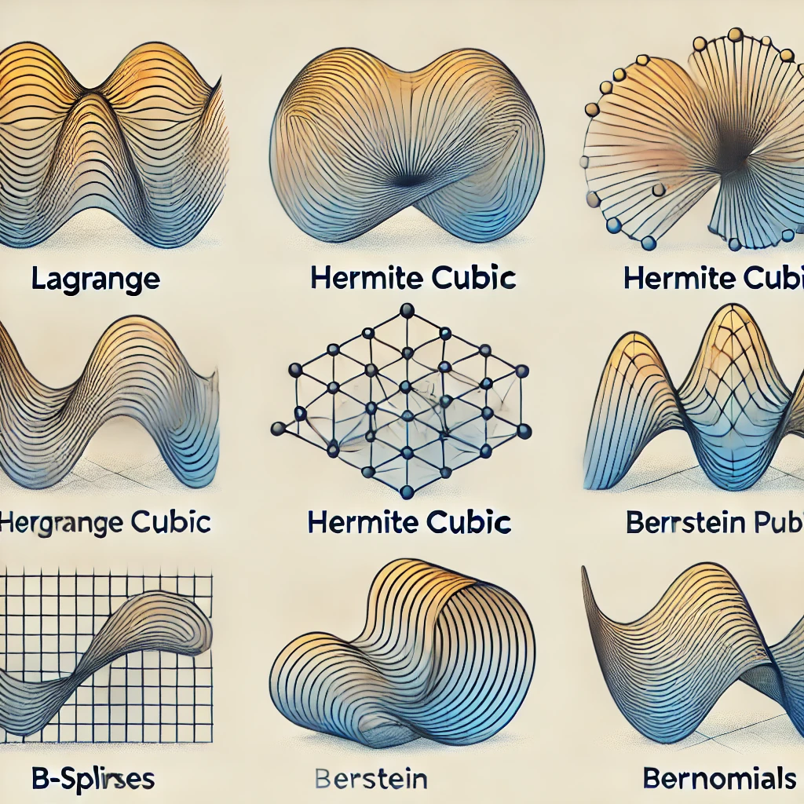
introduction
Polynomial basis functions are mathematical tools used to create curves and surfaces in computer graphics. They provide the foundation for interpolation and shape modeling by constructing polynomials that pass through or approximate a set of points. This enables smooth transitions and precise control, which are essential in applications like animation, CAD, and 3D modeling.
T
1
1

Slide 6
Four types of polynomial functions
02
T
2

Slide 7
Lagrange Polynomials of Degree n
FUNCTIONS
Hermite cubic polynomials
B-Splines
Bernstein polynomials
2

Slide 8
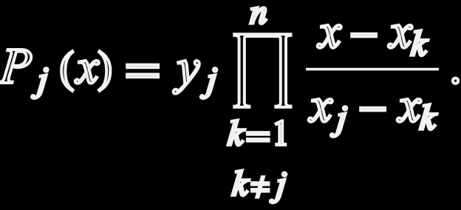



Lagrange Polynomials of Degree n
Lagrange polynomials of degree n are used for polynomial interpolation, where they provide a way to approximate a function that passes through n+1 given data points.
Here, and = 0 for all k $≠j$
$$P_{j}\left(x_{j}\right)=1$$
$$P_{j}\left(x_{k}\right)$$
T
2
3

Slide 9

Hermite Cubic polynomials
Hermite cubic polynomials are interpolation polynomials used to match both function values and derivatives at given points, ensuring smooth transitions between points.
$$H\left(x\right)=\left(2t^{3}−3t^{2}+1\right)P_{0}+\left(t^{3}−2t^{2}+t\right)h_{0}+\left(−2t^{3}+3t^{2}\right)P_{1}+\left(t^{3}−t^{2}\right)h_{1}$$
Here,
• $P_{0}$ and $P_{1}$are the function values at the points $x_{0} and x_{1}$.
• $h_{0} and h_{1}$ are the derivatives (slopes) at $x_{0} and x_{1}$.
• $t=\frac{x−x_{0}}{x_{1}−x_{0}}$ is the normalized parameter.
T
2
4

Slide 10
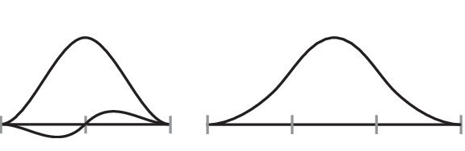
Hermite Cubic polynomials
Figure : Hermite Cubic Polynomials
T
2
5

Slide 11
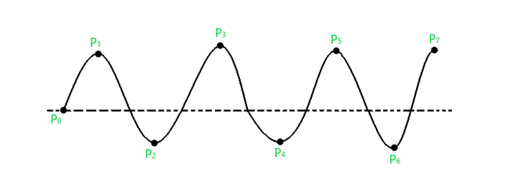
B-splines
B-splines (Basis splines) are a family of piecewise polynomial functions used for curve fitting and interpolation, providing smooth curves with local control and continuity.
Figure : B-splines
T
2
6

Slide 12
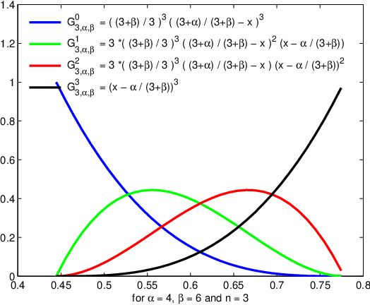


Bernstein polynomials
Bernstein polynomials are used to approximate continuous functions with a sum of weighted terms, ensuring smooth convergence.
$$BE_{k,n}\left(x\right)=\frac{n!}{k!\left(n−k\right)!}x^{k}{\left(1−x\right)}^{n−k} ,$$
$$0≤x≤1$$
T
2
7

Slide 13
03
Conclusion
T
3

Slide 14
conclusion
Lagrange Polynomials : Interpolate data points.
Hermite Polynomials : Interpolate values and slopes.
B-splines : Provide smooth, local control.
Bernstein Polynomials : Approximate functions smoothly.
T
3
8

Slide 15
Thank you

